Slide 1


RESTAURANT WEBSITE
FIRST SEMESTER PROJECT
COURSE: ITC LAB
Course teacher: GROUP MEMBERS:
Miss Aman MARYAM
Lab teacher: AND
Miss wadeeah MUHAMMAD ASIM

Slide 2
TABLE CONTENT :-
INTRODUCTION……………………………………………………
TASK DISTRIBUTION……………………………………………….
TECHNOLGY…………………………………………………………….
FEATURES………………………………………………………………...
PROS…………………………………………………………………………

Slide 3
INTRODUCTION:-
Our restaurant’s website is the core of your online presence.
The site conveys the soul of your restaurant in the virtual world.
The heart of all your campaigns that you run to promote yourself online, which clearly is where your customers are too.
Some aspects that are essential an we use includes : (Reservations , menu, contact details, locations, food gallery picture etc.) we also use background color.

Slide 4
TASK DISTRIBUTION:
REGISTRATION NO | MEMBER NAME | TASKS
SP22-BSSE-0028 | MARYAM NAZ | BACKGROUND PICTURES, INFORMATION , FOOD ITEMS PICTURES, LOCATION
SP22-BSSE-0022 | MUHAMMAD ASIM | MENU LIST, RESERVATION , CONTACT US,HEADER BUTTONS

Slide 5
TECHNOLOGY:-
Some basic technologies we use in our restaurant
website that are HTML , CSS And
the software we use is Visual Studio .

Slide 6
FEATURES:-
Our Features of Websites for Restaurants are
Contact information so that user can get information easily.
Menu page.
Great images of our desi food.
online reservations by following some steps.
Images of your chef .
A website background that matches our restaurant’s style .

Slide 7
PROS:-
In our website user get information about restaurant .
They can easily see our menu,
our chef specialist,
reservation page after entering name and email address ,
see our open hours,
contact numbers,
Share message,
and address we provide.

Slide 8
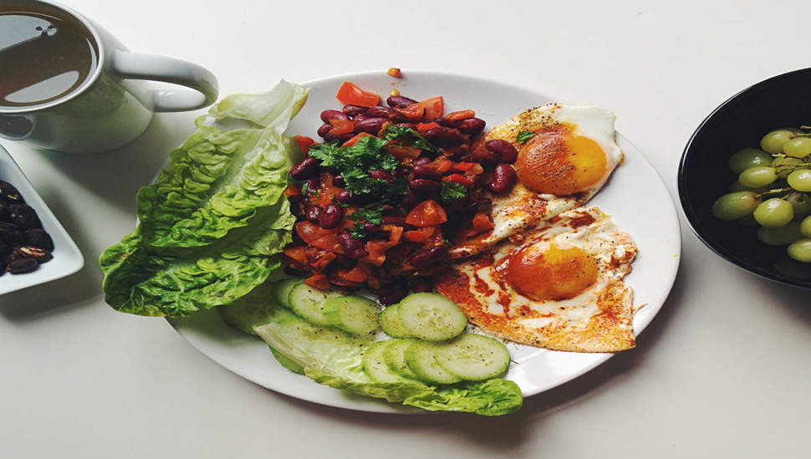
THANKYOU

